Slide 1
Coursera Capstone Project for IBM Data Science Specialization - Week 2
By
Ahmed Gamal Mohamed

Slide 2
introduction
Background
Dallas city is one of the most populous city in U.S. and is home to many immigrant population in Texas after San Antonio and Houston.
Being an metropolitan city, Dallas is also home to many restaurants which serves wide variety of cuisines. Owing to significant number of Indian expatriate population, Dallas City and its nearby Suburbs have handful of Indian restaurant.
So, as a part of this project the Indian restaurants in Dallas city will be listed and visualized.

Slide 3
introduction
Problem Description
By utilizing the Dallas City restaurants inspection data, Indian Restaurants in Dallas City and their risk category will be Analyzed. Secondly, a classifier model will be built to predict the risk categories of restaurants. Furthermore, using the foursquare API we will get the ratings of Indian Restaurants in Dallas City.
Target Audience
People looking to open new restaurants
Restaurants
Travelers who love Indian food

Slide 4
DATA
For this project we will use the following data :
1. Dallas City restaurants inspection data from 2016-2019
* Data source : https://www.dallasopendata.com/api/views/dri5-wcct/rows.csv?accessType=DOWNLOAD
* Description : This data set contains 37876 rows and 114 columns contains Restaurant Name, Street Name, violation descriptions along with their latitude and longitude.
2. Ratings of Indian restaurants for selected locality in Dallas City
* Data source : Foursquare API
* Description : By using this api we will get all the ratings for Indian restaurants in selected neighborhood

Slide 5
Approach
Collect the Dallas City Restaurants Inspection data from https://www.dallasopendata.com/api/views/dri5-wcct/rows.csv?accessType=DOWNLOAD
Analyze the restaurants based on their risk category
Built a machine learning model for predicting the risk category the restaurants are placed
Filter out all venues from the inspection data that are Indian Restaurants.
Find rating , tips and like count for each Indian Restaurants using Foursquare API.
Using rating for each restaurant , we will sort that data.
Visualize the Ranking of neighborhoods using folium library(python)

Slide 6
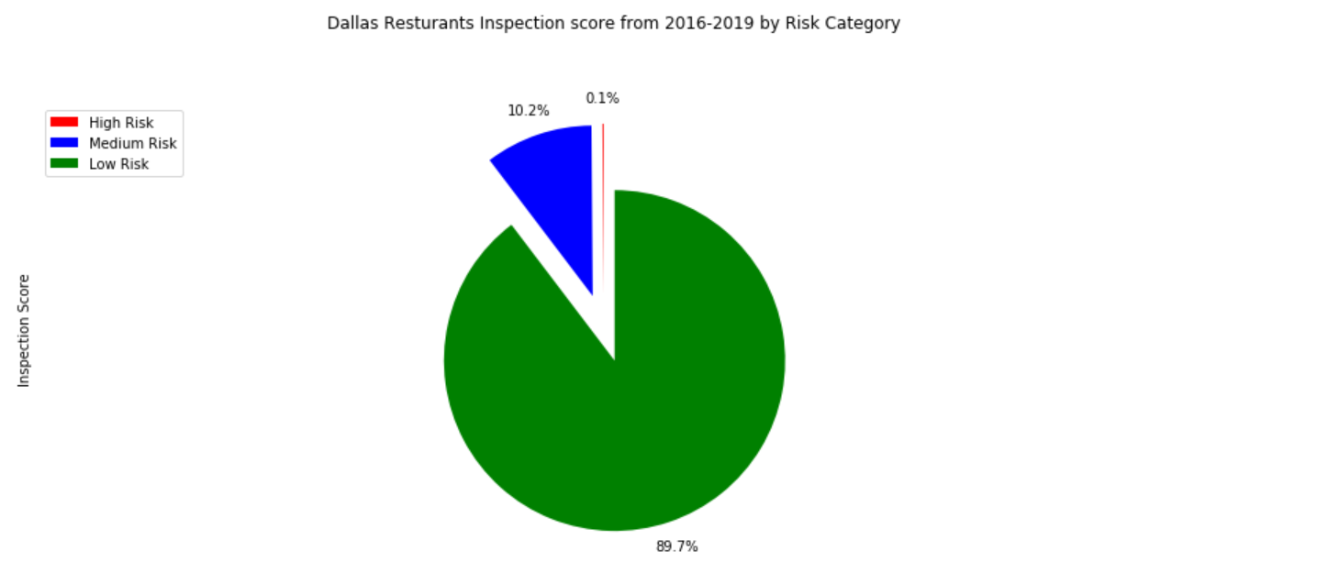
Dallas City Inspections from 2016-2019

Slide 7
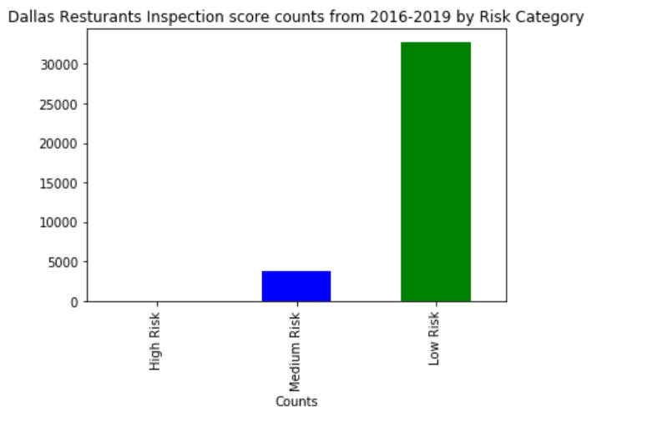
Inspections Counts from 2016-2019

Slide 8
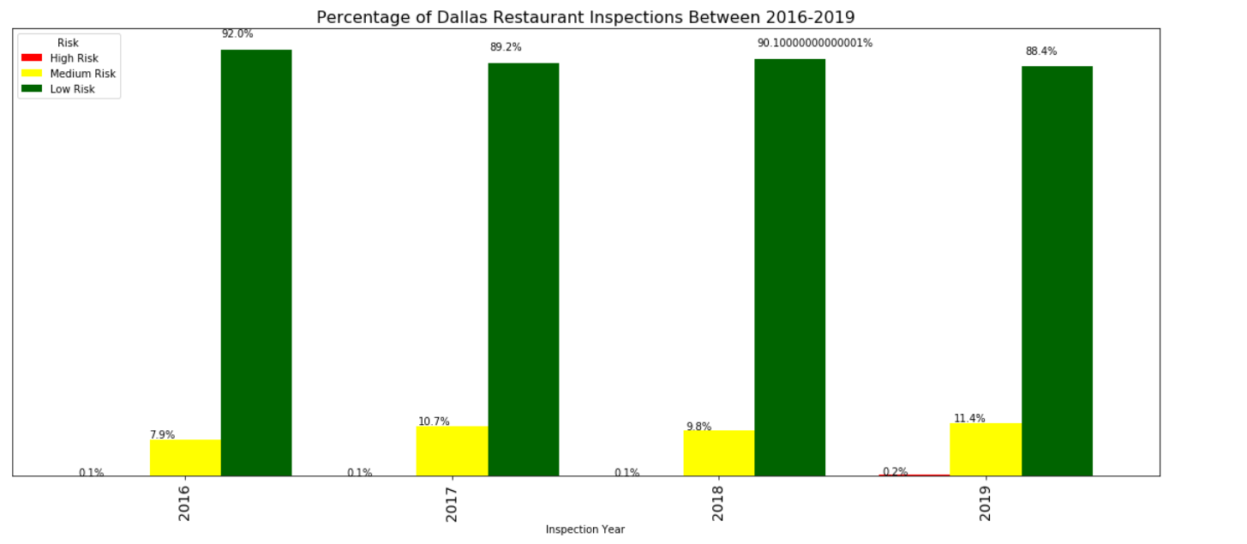
INSPECTIONS By Year

Slide 9
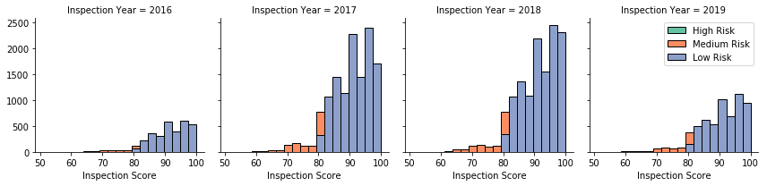
INSPECTIONS By Year

Slide 10
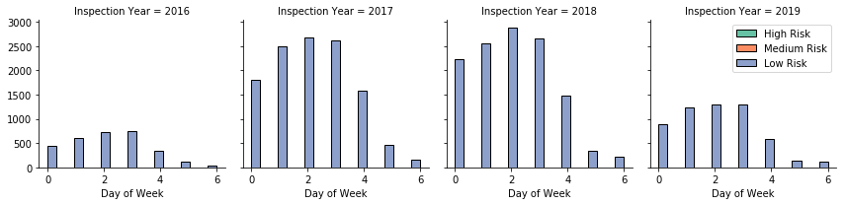
Overall inspection based on day of week

Slide 11
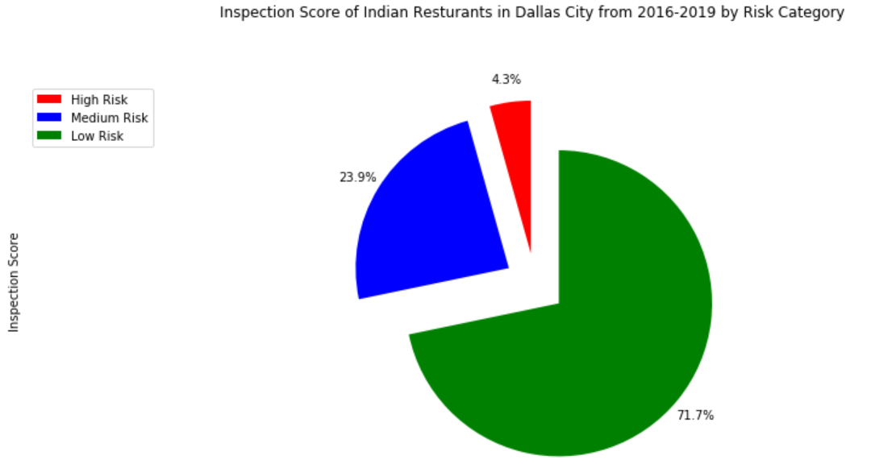
Indian Restaurants Inspections by year

Slide 12
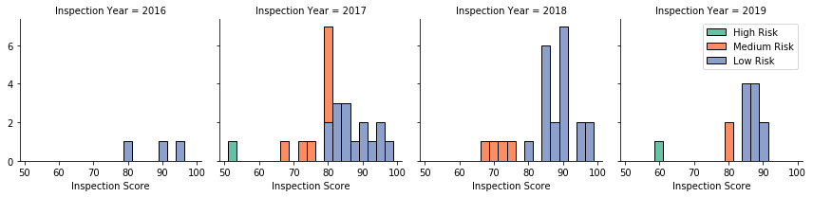
Indian Restaurants Inspections by year

Slide 13
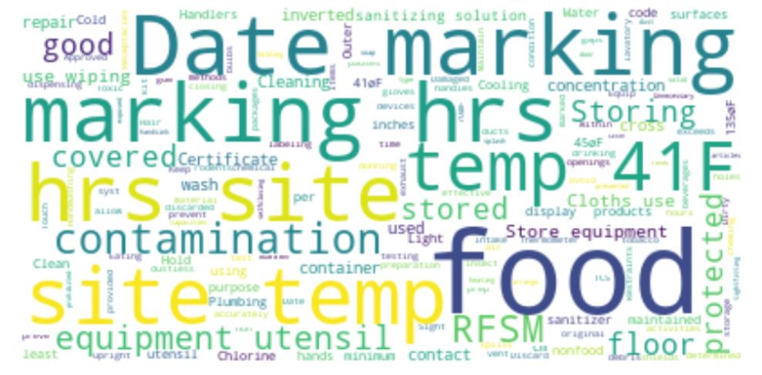
Word Cloud for Violation Description of Indian Restaurants from 2016-2019

Slide 14
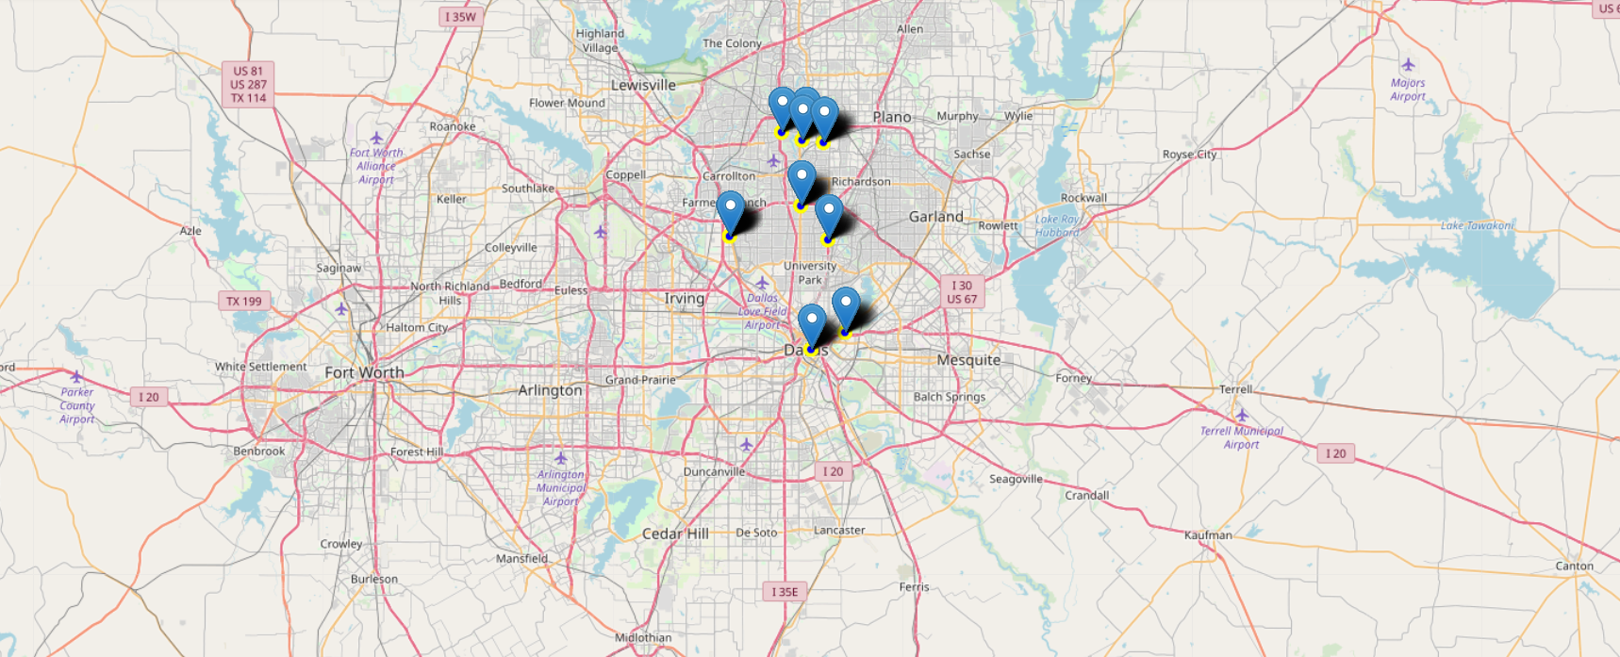
Indian Restaurants Visualizations

Slide 15
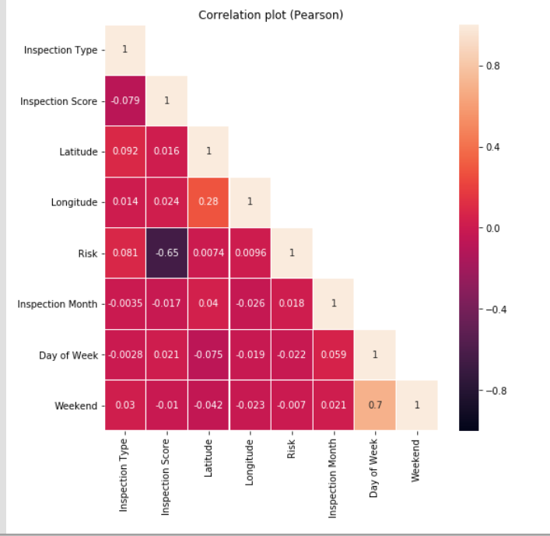
Feature Correlations

Slide 16
Machine Learning Results
Machine Learning Algorithm | Accuracy Score
Decision Tree Classifier | 0.9988801791713325
Random Forest Classifier | 0.9988801791713325

Slide 17
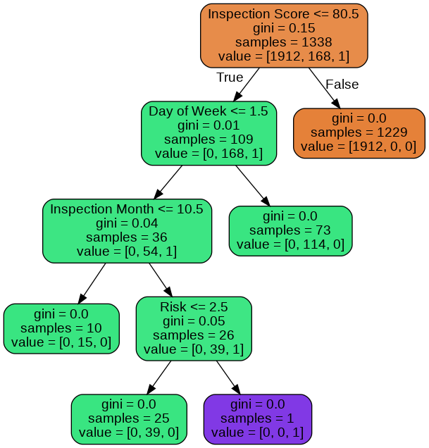
Sample Tree from the Random Forest Model

Slide 18
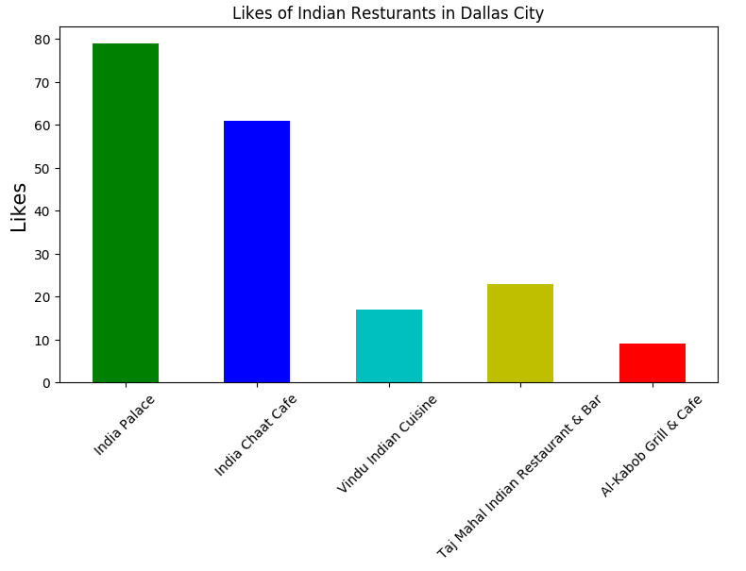
Likes received by the Indian Restaurants from Foursquare API

Slide 19
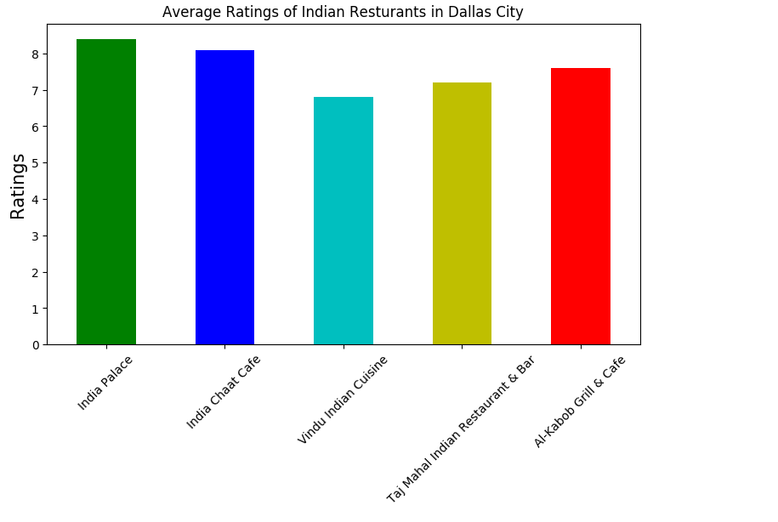
Average Ratings received by the Indian Restaurants from Foursquare API

Slide 20
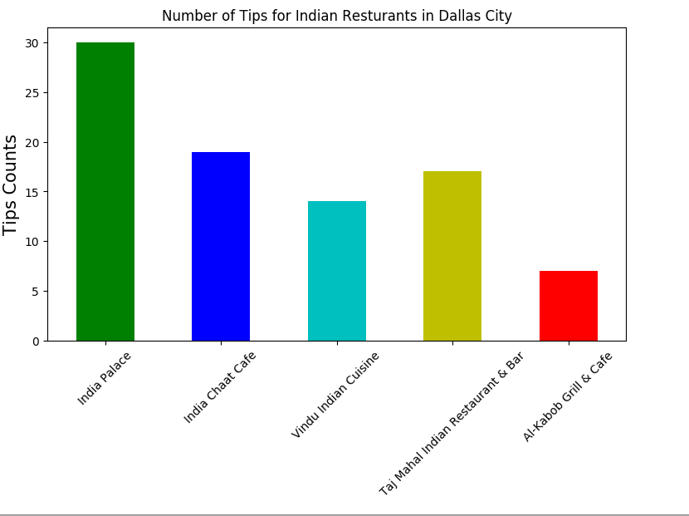
Number of Tips for the Indian Restaurants from Foursquare API

Slide 21
Conclusions
This project successfully completes my IBM Data Science Professional Certification Training. I am quite new to the data science and I had a steep learning curve during the course. I have really enjoyed doing all the lab exercises and the courses were really informative.
The following are the conclusions that I derive from this project:
Dallas City have only very few Indian restaurants. Hence, it has a potential market for opening a new Indian restaurant
Roughly 80% of Indian restaurants that are currently present in Dallas City are placed in low risk category based on the inspection data from 2016-2019
A decision tree classifier model is built for classifying the restaurants into various risk categories and the model performs well for the given data set. This will help the restaurants in predicting their risk category for a given year.
The Indian restaurants in the Dallas City were visualized using the folium map rendering library
Using Foursquare API, the venue details for the Indian restaurants were analyzed and found that among all the restaurants in Dallas City India Palace is the best place to dine.

Slide 22
Limitations and Future Work
The restaurants are ranked solely on the data provided by Foursquare API. If data on other demographics are available this can be improved
The accuracy of location data depends on Dallas City Inspection Data and Foursquare API. Hence, need to be analyzed further as there are some ambiguous entries.
The machine learning model will be further improved as the model developed may be prone to over-fitting

